Slide 1
Semantic Parsing for Single-Relation Question Answering
Scott Wen-tau Yih
Joint work with Xiaodong He, Chris Meek
Microsoft Research

Slide 2

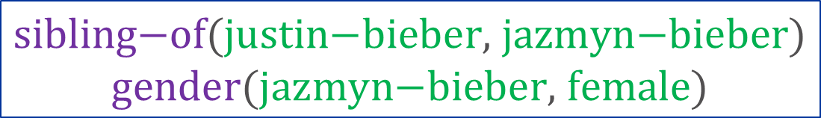
Question Answering using Knowledge Base
Who is Justin Bieber’s sister?
semantic parsing
$$λx. \text{sister}\text{−}\text{of}\text{(}\text{justin}\text{−}\text{bieber}\text{,} x\text{)}$$
Jazmyn Bieber
query
inference
Knowledge Base
$$\text{sibling}\text{−}\text{of}\text{(}\text{justin}\text{−}\text{bieber}\text{, }\text{jazmyn}\text{−}\text{bieber}\text{)}$$
$$\text{gender}\text{(}\text{jazmyn}\text{−}\text{bieber}\text{,} \text{female}\text{)}$$

Slide 3
Single-Relation Questions (1/2)
Most common questions in the search query logs
“How old is Kirk Douglas, the actor?”
“What county is St. Elizabeth MO in?”
“What year was the 8 track invented?”
“Who owns the Texas Rangers?”
Foundation for answering complicated questions
“Name a director of movies starred by Tom Hanks.”
CKY parsing that chains answers of single-relation questions [Bao et al., 2014]

Slide 4
Single-Relation Questions (2/2)
Challenge: lots of ways to ask the same question
“What was the date that Minnesota became a state?”
“Minnesota became a state on?”
“When was the state Minnesota created?”
“Minnesota's date it entered the union?”
“When was Minnesota established as a state?”
“What day did Minnesota officially become a state?”
⋯

Slide 5
Key Ideas & Related Work
Simple Context-Free Grammar
Separate a question into a relation pattern and an entity mention
Match pattern/mention and KB relation/entity using convolutional neural networks
Inspired by Paralex [Fader et al. 2013]
35M question paraphrase pairs from WikiAnswers
Learn weighted lexical matching rules

Slide 6
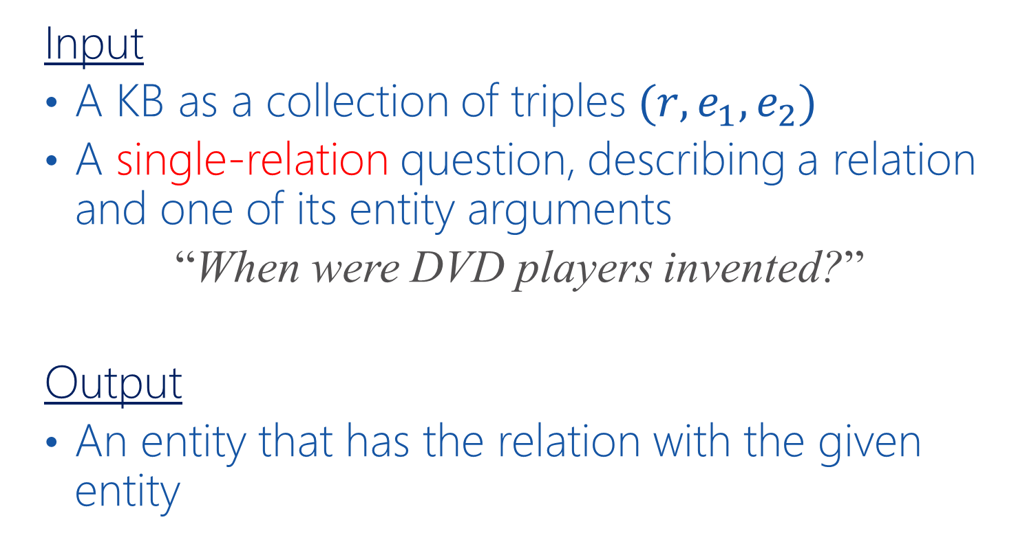
Task & Problem Definition
Input
A KB as a collection of triples $(r, e_{1},e_{2})$
A single-relation question, describing a relation and one of its entity arguments
“When were DVD players invented?”
Output
An entity that has the relation with the given entity

Slide 7
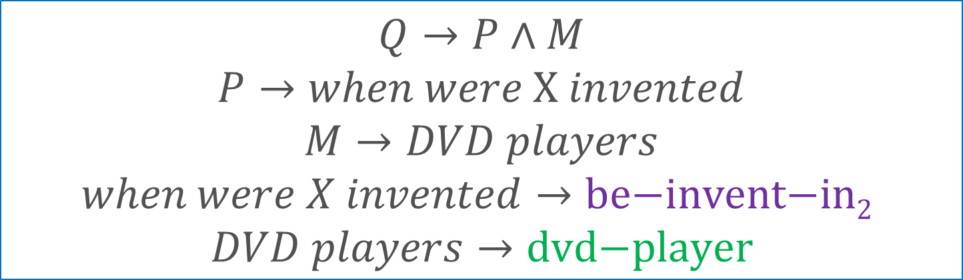
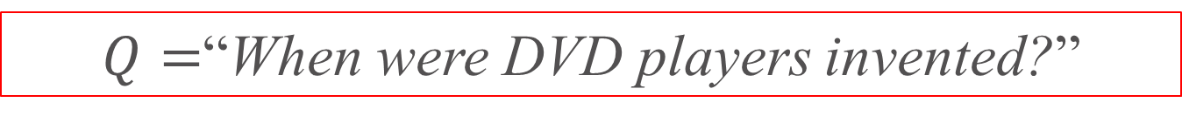
High-level Approach: Semantic Parsing
$Q=$“When were DVD players invented?”
$$Q→P∧M$$
$$P→when were X invented$$
$$M→DVD players$$
$$when were X invented→\text{be}\text{−}\text{invent}\text{−}\text{in}\text{2}$$
$$DVD players→\text{dvd}\text{−}\text{player}$$
$$λx. \text{be}\text{−}\text{invent}\text{−}\text{in}\text{(}\text{dvd}\text{−}\text{player}\text{,} x\text{)}$$

Slide 8

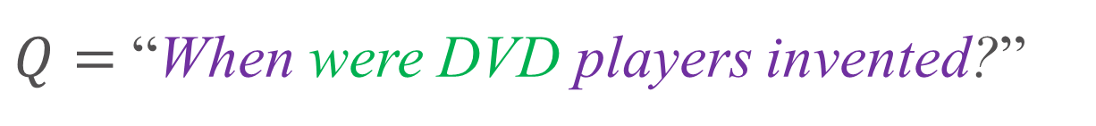
Procedure: Enumerate All Hypotheses
$Q=$ “When were DVD players invented?”
$P→when X players invented$
$M→were DVD$

Slide 9

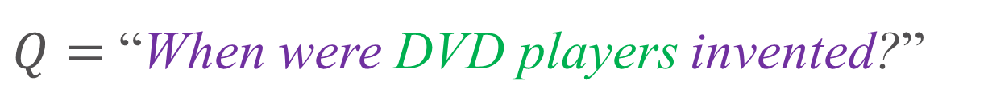
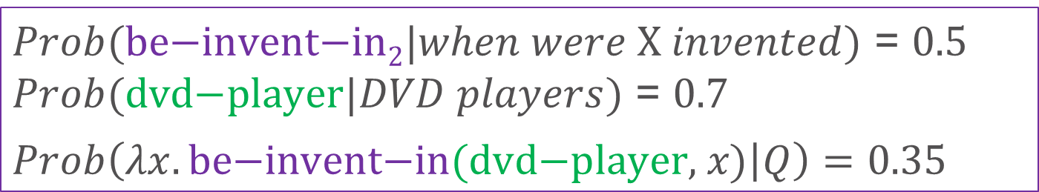
Procedure: Enumerate All Hypotheses
$Q=$ “When were DVD players invented?”
$P→when were X invented$
$M→DVD players$
$Prob(\text{be}\text{−}\text{invent}\text{−}\text{in}\text{2}|when were X invented)$ = $0.5$
$Prob(\text{dvd}\text{−}\text{player}|DVD players)$ = $0.7$
$Prob\left(λx. \text{be}\text{−}\text{invent}\text{−}\text{in}\text{(}\text{dvd}\text{−}\text{player}\text{,} x\text{)} | Q\right)=0.35$
Semantic Matching via Siamese Neural Networks!

Slide 10
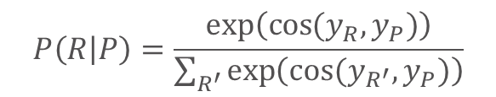

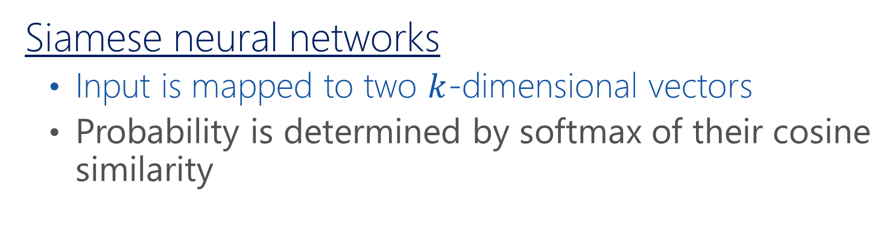



Convolutional Deep Semantic Similarity Model [Shen et al., 2014] (1/2)
Siamese neural networks
Input is mapped to two $k$-dimensional vectors
Probability is determined by softmax of their cosine similarity
$$P\left(R | P\right)=\frac{exp⁡\left(\cos{(y_{R},y_{P})}\right)}{\sum_{R^{′}}{\exp\left(cos⁡(y_{R^{′}},y_{P})\right)}}$$
$$y_{P}∈R^{k}$$
$$y_{R}∈R^{k}$$
$$when were X invented$$
$$\text{be}\text{−}\text{invent}\text{−}\text{in}\text{2}$$

Slide 11
Convolutional Deep Semantic Similarity Model [Shen et al., 2014] (2/2)

Slide 12
Experiments: Data
Knowledge base: ReVerb [Fader et al., 2011]
Relation | Entity Argument #1 | Entity Argument #2
be-official-language | chinese-and-english | hong-kong
be-second-largest-city-in | arequipa | peru
be-tallest-mountain-in | ararat | armenia
have-population-of | city-of-vancouver | 587,891
provide | microsoft | office-software
use-for | laser | lasik
… | … | …

Slide 13
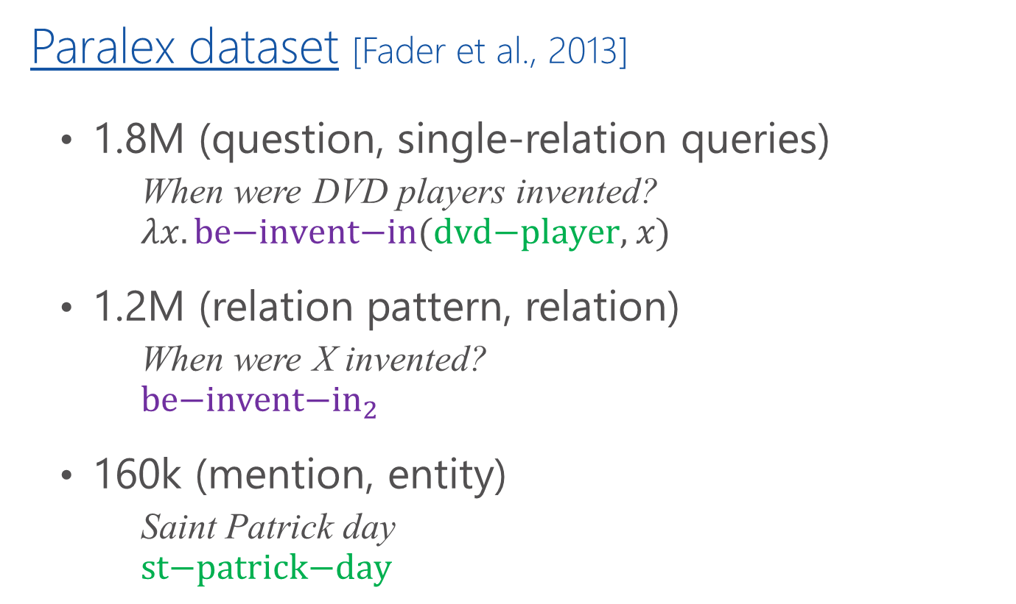
Experiments: Data
Paralex dataset [Fader et al., 2013]
1.8M (question, single-relation queries)
When were DVD players invented?
$$λx. \text{be}\text{−}\text{invent}\text{−}\text{in}\text{(}\text{dvd}\text{−}\text{player}\text{,} x\text{)}$$
1.2M (relation pattern, relation)
When were X invented?
$${\text{be}\text{−}\text{invent}\text{−}\text{in}}_{2}$$
160k (mention, entity)
Saint Patrick day
$$\text{st}\text{−}\text{patrick}\text{−}\text{day}$$

Slide 14
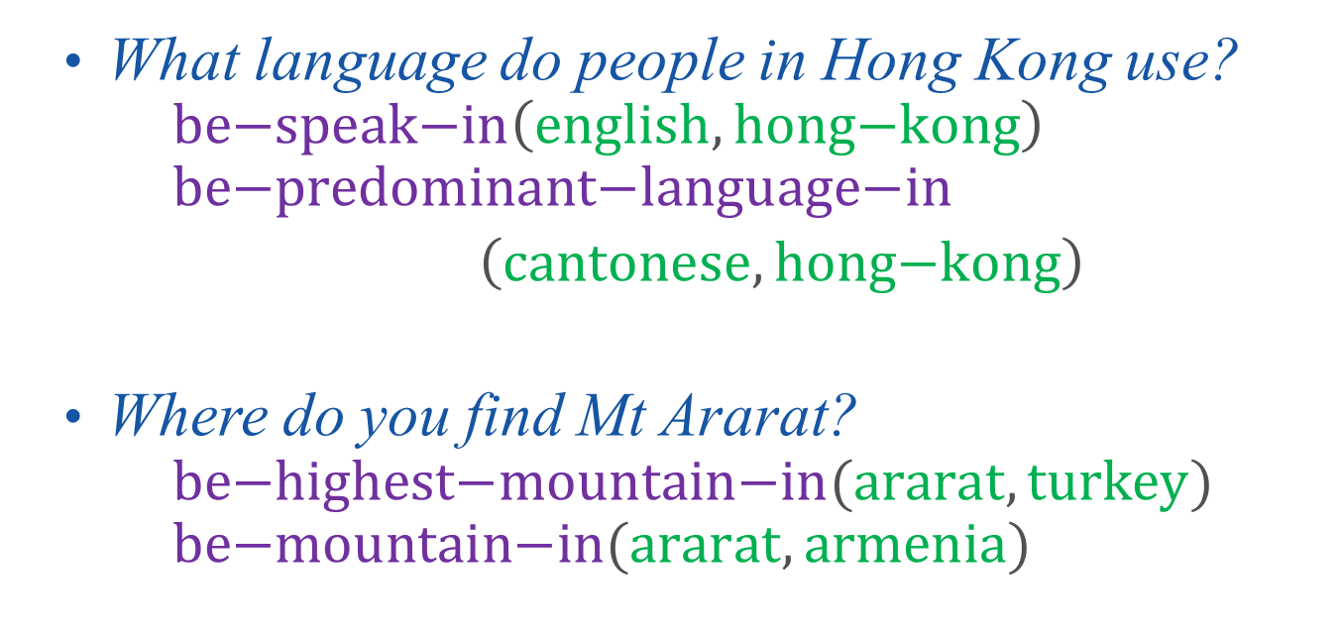
Experiments: Task – Question Answering
Same test questions in the Paralex dataset
698 questions from 37 clusters
What language do people in Hong Kong use?
$$\text{be}\text{−}\text{speak}\text{−}\text{in}\left(\text{english}, \text{hong}\text{−}\text{kong}\right) \\ \text{be}\text{−}\text{predominant}\text{−}\text{language}\text{−}\text{in}$$ $\left(\text{cantonese}, \text{hong}\text{−}\text{kong}\right)$
Where do you find Mt Ararat?
$$\text{be}\text{−}\text{highest}\text{−}\text{mountain}\text{−}\text{in}(\text{ararat}, \text{turkey}) \\ \text{be}\text{−}\text{mountain}\text{−}\text{in}(\text{ararat}, \text{armenia})$$

Slide 15
Experiments: Results
Ours: CNNSM
Paralex

Slide 16
Cherries
What is the national anthem in the France?
PARALEX: be-currency-in.r euro.e france.e
CNNSM: be-national-anthem-of.r la-marseillaise.e france.e
What is the title of france national anthem?
PARALEX: be-national-dog-of.r poodles.e france.e
CNNSM: be-national-anthem-of.r la-marseillaise.e france.e
What is the name of the national anthem of France?
PARALEX: be-national-language-in.r french.e france.e
CNNSM: be-national-anthem-of.r la-marseillaise.e france.e

Slide 17
More Cherries
What is the largest city in Peru?
PARALEX: be-city-in.r cabana.e peru.e
CNNSM: be-largest-city-in.r lima.e peru.e
When was Apple Computer founded?
PARALEX: be-founder-of.r steve-jobs.e apple.e
CNNSM: be-found-on.r apple-computer.e april-1-,-1976.e
What is the plural form of the word bacterium?
PARALEX: be-plural-form-of.r virii.e virus.e
CNNSM: be-plural-form-of.r bacterium.e bacterium.e

Slide 18
Some Lemmons
Where does cassava grow?
PARALEX: grow-in.r cassava.e tropical-and-subtropical-regions CNNSM: be-grow-by.r cassava.e poor-farmer.e
Where in the world are watermelon grown?
PARALEX: be-grow.r japanese-farmer.e square-watermelon.e
CNNSM: be-grow-in.r watermelon.e different-shape.e
What is the official theme song of France?
PARALEX: be-theme-song-for.r marseillaise.e french-revolution.e
CNNSM: be-recurrent-theme-in.r song.e mailbox.e

Slide 19
Conclusions
A new semantic parsing framework for single-relation questions
Semantic similarity function to match patterns and relations (also, mentions and entities)
Semantic similarity model – Convolutional neural networks with letter-trigram vector input
Go beyond bag-of-words and handle OOV better
Outperform lexical matching rules
Future work
Apply this approach to more structured KB (Freebase)
Extend this work to handle multi-relation questions

